Slide 1
Student Success and Support Program
Nuts and Bolts
Student Success and Support Program Implementation Summit
September 23, 2013

Slide 2
Presentation Overview
Origins and Purpose of the Student Success and Support Program (SSSP)
Overview of Title 5 regulations
Reporting requirements
MIS Data Elements
Funding formula and allocations

Slide 3
Presentation Overview (continued)
Student Equity Planning
Debra Sheldon, Chancellor’s Office, Student Services and Special Programs division
Statewide Technology Projects
Bonnie Edwards, Chancellor’s Office, Technology, Research and Information Systems division
Priority Enrollment Awareness Campaign
Melissa Conner, Foundation for California Community Colleges

Slide 4
Notes:
SB 1163

Slide 5
Student Success Act of 2012 (SB 1456)
First steps to begin implementation of SSTF recommendations:
2.2 – Require Orientation, Assessment and Ed Plans
2.5 – Require students to declare a course of study
3.2 – Incentivize success with BOGFW conditions (and enrollment priorities)
8.2 – Invest in a Student Support Initiative
Links funding to support:
7.3 Student Success Scorecard: Implement the accountability scorecard
2.1 Centralized Assessment: As a condition of receipt of funds, requires colleges to adopt common assessment if the college uses standardized assessment tests (when CCCAssess becomes available)
Notes:
Sen. Alan Lowenthal

Slide 6
Student Success and Support Program Planning and Implementation Timeline
Fiscal Year 2012-13
Fiscal Year 2013-14
Fiscal Year 2014-15
Fiscal Year 2015-16
Fiscal Year 2016-17
System-level Planning Year:
Implementation workgroups convened October 2012 to develop proposals for title 5 Matriculation revisions, new allocation formula, & revised MIS data elements & definitions
New program planning & budget process developed
SB 1456 effective January 1, 2013
District/College-level Planning Year:
Allocations based on enrollment only, new formula not applied
Funding targeted to core services (1-year exemption permitted by request)
Develop program plans
Implement MIS changes to ensure accurate and complete data reporting
Regulations effective October 19, 2013
Convene noncredit work group
District/College-level Implementation Year 1:
Program plans and budgets submitted
Continue to ensure accurate and complete data reporting
Allocations based on enrollment only, new formula not applied
First legislative implementation report due July 1, 2014 (biannually thereafter)
Implementation Year 2:
FY 15-16 allocations based on 14-15 year-end data reported
Application of funding formula begins this year
80% of prior year funding guaranteed
Implementation Year 3:
FY 16-17 allocations based on 15-16 year-end data reported
50% of prior year funding guaranteed (returns to 95% thereafter)
Legislative report due July 1, 2016

Slide 7
Student Success and Matriculation Support Program
Known as the Matriculation Program
8 funded components
Colleges required to provide core matriculation services, but students not required to complete them
Stand-alone program planning
Funding allocated based on enrollment data for new and continuing students
Incomplete data reporting on matriculation services
Now called the Student Success and Support Program
3 funded core services:
orientation, assessment, counseling, advising, and other student education planning services
Institutional AND student requirements
Incentivizes student completion of core services
Clear link to student equity planning
Funding formula includes services provided as well as enrollment
Data required for funding
Linked to Student Success Scorecard
Notes:
Focus resources on core services
Incentives provided through priority registration and course registration
Directly address equity & achievement gap issues:
Scorecard & Student Equity Planning
Accreditation and Program Review
Incentivize colleges to put resources where research shows impact on success
In the process make data reporting valuable

Slide 8
Student Success and Support Program Scope and Intent
…Student Success is the responsibility of the institution and student, supported by well-coordinated and evidence based student and instructional services to foster academic success.
Title 5, Section 55500
Notes:
Premise of SB 1456
Student Responsibilities: All students shall be required to: identify an education and career goal; diligently engage in course activities and complete assigned coursework; and complete courses and maintain progress toward an education goal and completing a course of study.
College’s Responsibilities: By Spring 2015, initial implementation of core services for 1st-time students

Slide 9
Student Success and Support Program Core Services
Orientation:
A process that acquaints students and potential students with, at a minimum, college programs, student support services, facilities and grounds, academic expectations, institutional procedures, and other appropriate information…
Title 5, Section 55521
Notes:
Section 55521
Academic expectations and standards
Requirements to maintain priority registration and BOG Fee Waiver eligibility
Process to challenge prerequisites and co-requisites
Academic calendar
Fees

Slide 10
Student Success and Support Program Core Services
Assessment for Placement:
The process of gathering information about … the student's study skills, English language proficiency, computational skills, aptitudes, goals, learning skills, career aspirations, academic performance, and need for special services. Assessment methods may include, but not necessarily be limited to, interviews, standardized tests, attitude surveys, vocational or career aptitude and interest inventories, high school or postsecondary transcripts, specialized certificates or licenses, educational histories, and other measures of performance.
Education Code section 78213
Notes:
Education code section 78213
Does not require a test
If using a test:
Must be validated and approved by CCCCO
Must use multiple measures
Must use common assessment

Slide 11
Student Success and Support Program Core Services
Counseling, Advising, Other Education Planning Services:
All first-time students expected to have:
Abbreviated Ed Plan is 1-2 semesters in length
- or -
Comprehensive Ed Plan …take(s) into account a student’s interests, skills, career and education goals, major, potential transfer institutions, and the steps the student needs to take…to complete their identified course of study.
Title 5 Section 55524
Notes:
Required for priority enrollment.
Abbreviated SEP when comprehensive plan isn’t appropriate.
Exploratory or short-term program
Comprehensive SEP linked to Course of Study
Required after 15 semester units or prior to completing 3rd semester
Institution required to provide opportunity
Can withhold transcripts and services
Applies to “first-time students”

Slide 12
Student Success and Support Program Core Services
Student Follow-up:
Required for at-risk students
Enrolled in Basic Skills courses
Have not identified an education goal and course of study
Are on Academic or Progress Probation – at risk of losing enrollment priority and BOG Fee Waiver
Notes:
Required gets greater weight in funding formula
Follow-up for other students also funded, at lesser rate

Slide 13
Student Success and Support Program Reporting Requirements
Student Success and Support Program Plan
Mid-Year Report (Declaration of Unused Funds)
Year-End Expenditure Report
Management Information System (MIS) data reporting

Slide 14
Student Success and Support Program Program Plan and Budget Plan
Describes how the college will:
Provide services
Allocate program and institutional matching resources
Fulfill title 5 requirements
Integrate the program with Student Equity and other planning processes
Submitted every three to five years, updated annually.
Will be due October 17, 2014 for 2014-15 through 2016-17.
Notes:
Activities must be explained in plan in order to be funded
Important elements of the program plan will include how services are delivered, student equity, staffing, partnerships with exterior agencies, technology being utilized, and coordination with student success and student equity goals.

Slide 15
Student Success and Support Program Plan
Divided into five sections:
Cover and Signature Page
Student Success and Support Program Services
Orientation
Assessment
Counseling, Advising, and Other Education Planning Services
Follow Up for At-Risk Students
Policies and Professional Development
Program Budget
Attachments
Notes:
Signatures are required from the District Chancellor, College President, Academic Senate President, Chief Student Services Officer and the Student Success and Support Program Coordinator.
Not required to have district governing board formally approve the plan

Slide 16
MIS Data Collection
Reporting Matriculation services was always required but there were no benefits or consequences for colleges to incentivize accurate or complete data.
SB 1456 requires services provided to students be a factor in allocating Student Success and Support Program funds.
The data elements were revised in July 2013 by the MIS Data and Funding Formula Work Group.

Slide 17
Student Success Data File
New Data File (SS)
Optional for 2013-14, Mandatory for 2014-15
Current Matriculation Data file (SM) will be collected thru academic year 2013-14.
MIS will be offering a follow-up webinar in October 2013 with more detailed discussion on the individual SS data elements.
Notes:
Myrna Huffman presenting break-out session B6 at 4:00 PM in the Garden/Terrace room

Slide 18
Student Success and Support Program Funding Guidelines

Slide 19
New Credit Funding Formula
Factors:
Number of Credit Students at Each College
Number of Students Who Received:
Orientation
Assessment
Counseling
Advising
Other Educational Planning Services

Slide 20
SB 1456 Student Success and Support Program Credit Funding Formula
College’s Potential Population of Students to Receive Services
Students Served at the College
College Match
Initial Orientation (SS06)** 10%
Initial Assessment (SS07)** 10%
Abbreviated SEP (SS09)** 10%
Counseling/Advising (SS08) 15%
Comprehensive SEP (SS09) 35%
At Risk Follow-Up Svc (SM10) 15%
Other Follow-Up Svc (SM11) 5%
3:1***
Unduplicated Credit Student Headcount*
(academic year =
summer, fall, winter, spring)
Base Funding
Floor $35K or 10%
(whichever is greater)
40%
**Include pre-enrollment services provided for students with SB record
*Includes CA resident students enrolled as of census in at least 0.5 credit units, (STD7) headcount status
“A,” “B,” “C,” excludes special admits
60%
***Match may include A&R, & SSSP related technology & research

Slide 21
a Example if SSSP (Credit) funded at $100 M…
College’s Potential Population of Students to Receive Services
Students Served at the College
College Match
Initial Orientation** 10%=$6M
Initial Assessment** 10%=$6M
Abbreviated SEP** 10%=$6M
Counseling/Advising 15%=$9M
Comprehensive SEP 35%=$21M
At Risk Follow-Up Svc 15%=$9M
Other Follow-Up Svc 5%=$3M
3:1
Unduplicated Credit Student Headcount*
(academic year =
summer, fall, winter, spring)
Base Funding
Floor $35K or
10% = $88,495
(whichever is greater, based on 10% of total state appropriation, divided by # of colleges)
40% = $40 M
60% = $60 M
Notes:
Allocation = $353,982 ($40 M/113) + College’s proportional share of Orientation $6M + Assessment $6M + SEP $6M + Counseling $9M + Comprehensive SEP $21M + At-Risk Follow-up $9M + Other Follow-up $3M

Slide 22
Phase-in for New Funding Formula
Goes into effect for 2015-16 allocations
Based on MIS data for 2014-15 enrollments and services (reported in August 2015)
2015-16 funding guaranteed at 80% of prior year allocations to allow for transition
2016-17 allocations guaranteed at 50% of 2014-15
2017-18 and beyond, guarantee returns to 95% of prior year for stability (as long as budget allows)

Slide 23
Funding Formula for 2013-14 and 2014-15
Allocations based on existing Matriculation formula:
2.4 X new credit students plus 1.0 X continuing credit students
Each college receives at least 95% of prior year’s credit allocation (if budget allows)
Minimum guaranteed base allocation of $50,000 for small colleges
Credit enrollment headcount based on prior year MIS data
Match requirement of 3:1
Notes:
Formula in place prior to implemented of Categorical Flexibility 2009-10

Slide 24
Noncredit Funding
Colleges administering non-credit programs certified eligibility in July 2013
Funding for FY 2013-14 and 2014-15 will be based on formula used from 2001-02 through 2008-09
Separate noncredit Program and Budget Plans will be required for 2014-15
New funding formula will be developed during 2013-14 for implementation in 2015-16
New formula will be based on a combination of eligible students and services
Notes:
Disappointment that Noncredit SSSP funding was not restored in this year’s budget
Chancellor’s Office will convene noncredit work group to review program guidelines and develop new funding formula
Need to coordinate with Adult Education review

Slide 25
Allowable Expenditures for College Match
Credit program requires 3:1 match Noncredit program requires 1:1 match
Matching funds must directly benefit SSSP, such as:
Orientation
Assessment for Placement
Student Education Planning
Counseling and Advising
Follow Up Services
Institutional Research and Technology directly related to provision of core services
Admissions and Records
Notes:
Match normally has to be consistent with allowable program expenditures
In response to situation of recovery from deep budget cuts, allowing match for A&R and other expenses that were allowed under Matriculation but not under SSSP
CBOs concerned, agreement to monitor

Slide 26
Student Equity Plan Update
Background
Recommendations
Requirements
Resources
Debra Sheldon
Student Services and Special Programs
dsheldon@cccco.edu

Slide 27
Student Equity Background
2002— BOG adopted recommendations of Task Force on Equity and Diversity for title 5 regulations requiring colleges to develop Student Equity Plan
2003— Chancellor's Office provided guidelines to colleges for development of the plan
2005— Chancellor's Office asked colleges to update/complete Student Equity plan

Slide 28
Student Equity Background
2008-09 to 2012-13 economic downturn resulted in:
State budget cuts
Suspension of many regulatory requirements
Categorical program flexibility
2011— Student Success Task Force established
2012— Student Success Act of 2012 (SB1456) and reaffirmation of student equity
2013—Student Equity Workgroup convened

Slide 29
Workgroup Recommendations
Integrate Student Equity planning into college and district wide planning efforts:
Accreditation
Educational master planning
Program review
Basic skills, etc.
Adopt a holistic approach to planning, budgeting, and delivery of services to support equity in student access and success

Slide 30
Student Equity Requirements
Student Equity Plan Timeline:
Plans due every 3-5 years with annual update
Initial Plan Due October 17, 2014
Notes:
30

Slide 31
Student Equity Requirements
Coordinate development of SSS Program Plan
(SB 1456) with the Student Equity Plan
Establish a Student Equity Planning Committee
Identify strategies to address/monitor equity
Mitigate disproportionate impact on students
Coordinate interventions and services for students at risk of academic progress or probation (Title 5, Section 55100)

Slide 32
Student Equity Requirements
Success Indicators:
Access:
Percentage of each pop. group enrolled compared group’s representation in adult pop. within community served – Census data; locally available data
Course Completion:
Ratio of number of credit courses that students by pop. group complete compared to number of courses in which students in that group are enrolled on the census day of term - DataMart
ESL and Basic Skills Completion:
Ratio of number of students by pop. group who complete a degree-applicable course after having completed the final ESL or basic skills course to the number of those students who complete such a final course - DataMart; Scorecard; Basic Skills Tracker
Notes:
32

Slide 33
Student Equity Requirements
Success Indicators:
Degree and Certificate Completion:
Ratio of number of students by pop. group who receive a degree or certificate to number of students in that group with same informed education goal as documented in student ed. plan – DataMart; Scorecard
Transfer:
Ratio of number of students by pop. group who complete a min. of 12 units and have attempted a transfer level course in math or English, to number in that group who transfer after one or more (up to six) years – DataMart; Scorecard
Notes:
33

Slide 34
Student Equity Planning Resources
Guidelines for Measuring Disproportionate Impact (DI) in Equity Plans
Simple Definition of DI:
“A condition in which some students’ access to key courses, resources, and supports and ultimately their academic success may be hampered by inequitable practices, policies and approaches.”
To assess equity, analyses should use one or more of the following disaggregated subgroups:
Gender
Ethnicity
Age
Disability Status
Economically Disadvantaged
Notes:
34

Slide 35
Student Equity Planning Resources
Guidelines for Measuring Disproportionate Impact in Equity Plans
Two methodologies:
Proportionality:
Compares the percentage of a disaggregated subgroup in an initial cohort to its own percentage in the resultant outcome group
“80-Percent Rule”:
Compares the percentage of each disaggregated subgroup attaining an outcome to the percentage attained by a reference subgroup
Notes:
35

Slide 36
Student Equity Planning Resources
A Guide to Assessing & Mitigating Disproportionate Impact in Student Success and Support Programs – Developed by the Research and Planning Group for CCC (RP Group)
The guide has been developed to:
Help colleges better understand concept of DI as it relates to SSSP components and the need to examine relevant data related to these services
Provide colleges with the tools that will help them conduct DI impact students
Present strategies that have the potential to mitigate DI
Notes:
36

Slide 37
Student Equity Planning Resources
Academic Senate for California Community Colleges:
http://asccc.org (includes papers related to equity and basic skills)
California Community Colleges Chancellor’s Office:
http://scorecard.cccco.edu
http://datamart.cccco.edu Includes basic skills, retention/success rate, etc.
Notes:
37

Slide 38
Student success
Technology Status Update
Bonnie Edwards
Telecommunications and Technology
bedwards@cccco.edu

Slide 39
Three Separate Grants
RFA 13-082: The Online Education Initiative
Governed through consortium agreements between colleges, this grant seeks to leverage technology to expand online education, streamline processes, improve success and retention, enhance student services and provide professional development support for online education.
RFA 13-083: The Common Assessment Initiative
Provide a common assessment instrument for each of the curricular areas of English, math and English as a Second Language and a common delivery, administration and data collection and evaluation system to the benefit of all California Community Colleges.
RFA 13-084: The Education Planning Initiative
Provide a comprehensive, technology-based education planning system. The system includes tools for education planning and degree audit as well as, an underlying system of data required for a statewide education planning. Underlying data includes, electronic transcripts, articulation between community colleges and to four year institutions, assessment and program inventories.

Slide 40
Request for Application (RFA) Timeline
September 3, 2013 | RFA Released
October 14, 2013 | Application Due Date
October 16-25, 2013 | Reading and Rating of Applications
October 28, 2013 | Intent to Award and Notification, Website post
December 1, 2013 | Grant Commencement Date

Slide 41
Online Education Initiative
Governed by Consortium Agreements
Between participating colleges
Address policy, procedure, etc.
Initial focus:
Advance Transfer Degree and other degree applicable courses
Streamlined Experience
Course discovery
Registration/enrollment
Common course management system
Student Services integration
Assessment
Proctoring
Tutoring
Planning and Advising
Articulation

Slide 42
Online Education Initiative
Professional Development
Quality Course Design
Online Teaching Certification
Address Support for:
Basic Skills
Credit by Exam
Next steps after award
Advisory Committee
Consortium agreement language
Request for Information - CMS
Request for Proposal –CMS
Colleges will not be required to migrate to CMS
Colleges must use the new CMS for courses offered through the Consortium

Slide 43
Common Assessment Initiative
Common assessment instrument
English
Math
English as a second language (ESL)
Common delivery and administration platform
Date Warehouse (Cal-PASS Plus)
Testing Information
Multiple Measures
Research
Expand knowledge and understanding of multiple measures
Validation

Slide 44
Common Assessment Initiative
Next steps after award
Reconvene Advisory Committee
Request for Proposal
Test selection/development

Slide 45
Education Planning Initiative
Support for all colleges
Existing education planning and/or degree audit system
No existing education planning and/or degree audit system
System of Data
CCC-CCC Articulation
Electronic transcripts
Program inventory
C-ID
Education Planning and Degree Audit Tool
Student Portal
Streamlined steps and messaging

Slide 46
Education Planning Initiative
Next steps after award
Advisory Committee
Discovery Process
Request for Information / Request for Proposal
Partner with existing programs/tools

Slide 47
Overarching Themes
Collaboration
Integration
Accessible data and tools
Security
Evaluation
Customer engagement (you)

Slide 49
Collaboration between the Foundation for California Community Colleges and the California Community Colleges Chancellor’s Office, supported by a $900,000 investment from the Kresge Foundation
Student outreach campaign and system-wide integrated website designed to encourage students to get on track and stay on track to complete their educational goals
Promotes “Priority Actions” to help students achieve and maintain priority enrollment:
Assessment
Orientation
Education Plan

Slide 51
Ongoing resource for students
Integration with CCCApply to allow for a more personalized user experience
Public version of the site also available

Slide 52
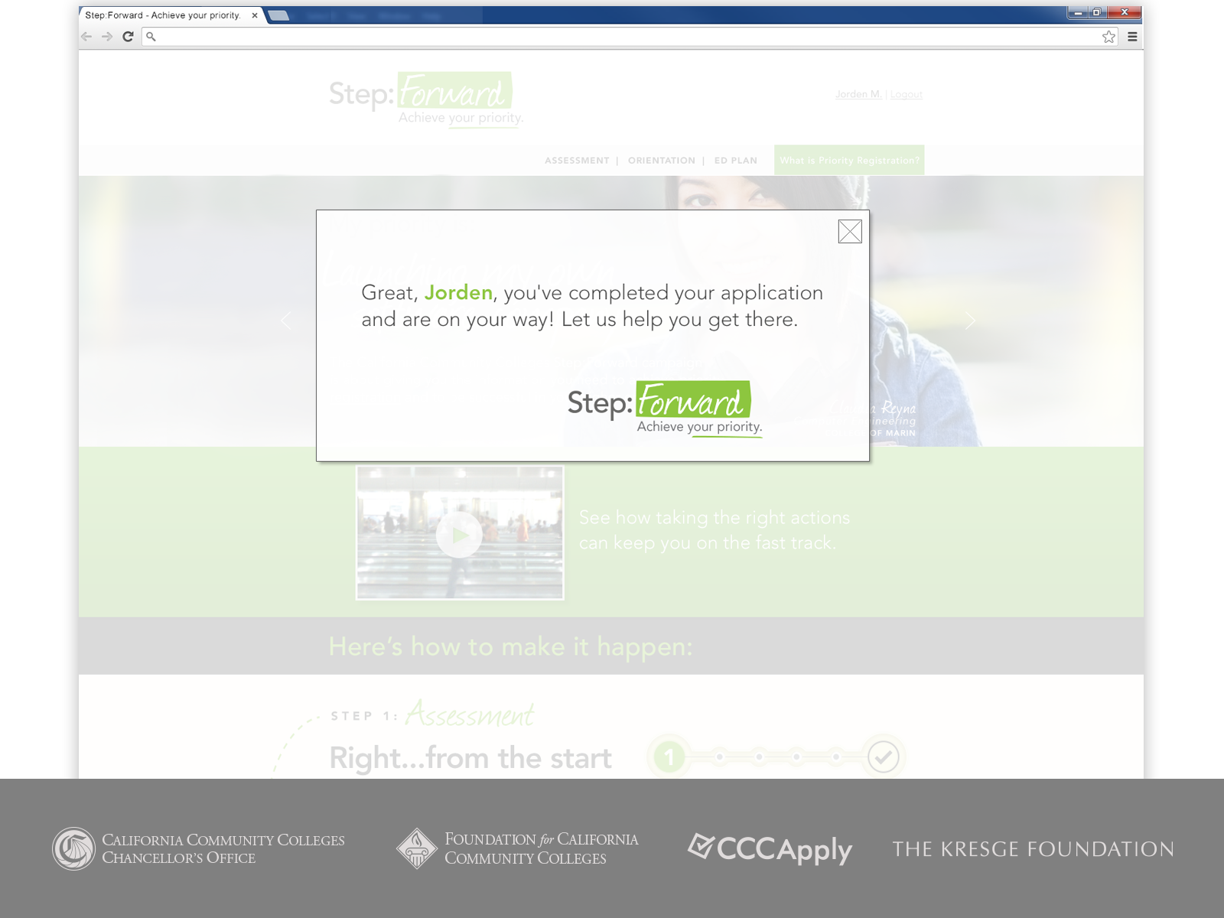

Slide 54
Stop by our table to learn more about the project and provide your feedback
Take a quick survey and sign up to win an iPad mini
Full roll-out for Fall semester 2014

Slide 55
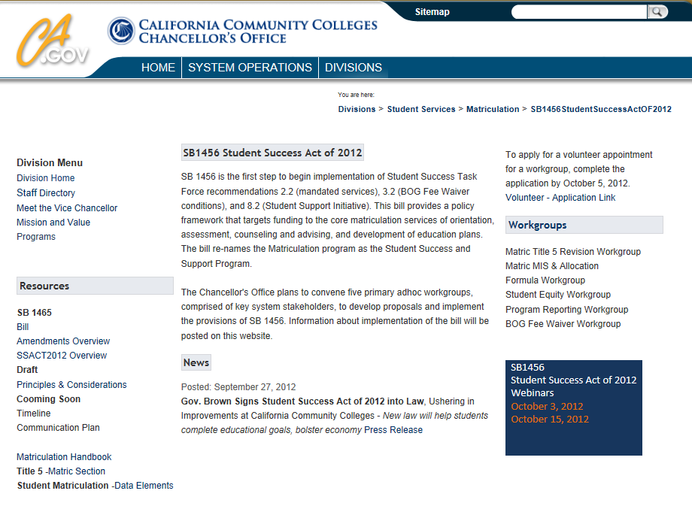
For Additional Information and Updates
http://extranet.cccco.edu/Divisions/StudentServices/ Matriculation/SB1456StudentSuccessActOF2012.aspx

Slide 56
Thank you.

